Slide 1
Dart

Slide 2
Flutter
Flutter is an incredible user interface (UI) toolkit for different platforms including iOS, Android, the web and more, all using one codebase.
Flutter is an exciting UI toolkit from Google.
Flutter uses the Dart language.

Slide 3
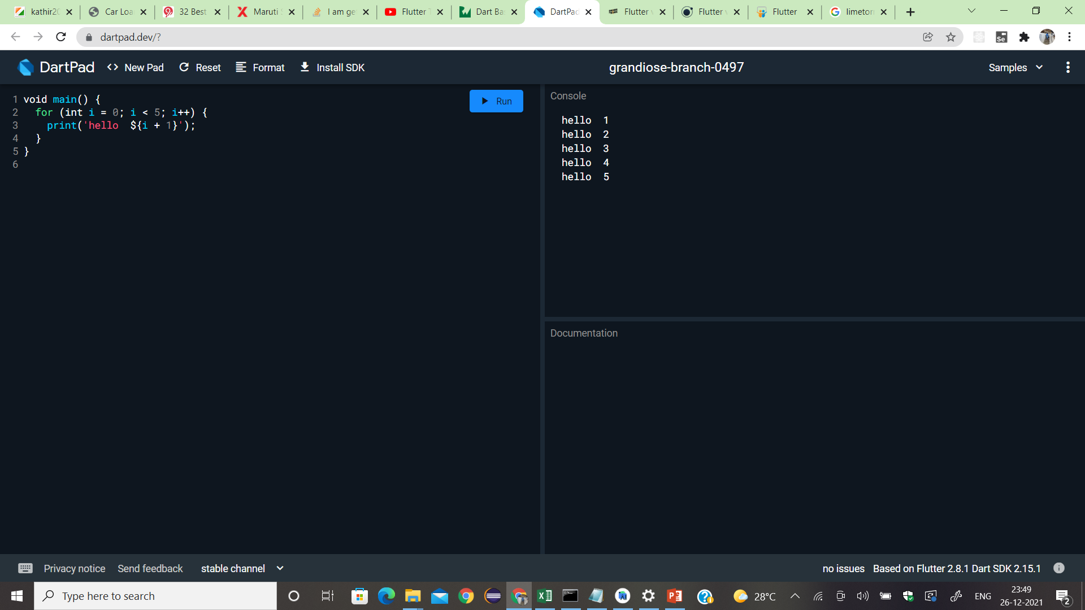
DartPad, A open-source tool (web based tool)

Slide 4
Why Dart?
Dart is similar to java, C#, Swift and Kotlin.
Some of its features include:
Statically typed
Type inference - Type inference is the automatic deduction of the data types of specific expressions in a programming language, usually done at compile time.
String expressions
Multi-paradigm including object-oriented and functional programming
Null safe - When you opt into null safety, types in your code are non-nullable by default, meaning that variables can’t contain null unless you say they can. With null safety, your runtime null-dereference errors turn into edit-time analysis errors.

Slide 5
Variables, Comments and Data Types
Variables hold the data that your program will work on.
It’s a computer’s memory that holds a value.
To denote a variable with Dart, use the var keyword.
var name=‘Ajay’;
Comments in Dart
// is a single-line comment,
/* ... */ is a multi-line comment block.
print(myAge); // This is also a single-line comment.
/*
This is a multi-line comment block. This is useful for long
comments that span several lines.
*/
Datatypes
Dart is statically typed.
If you don’t explicitly specify a data type, Dart uses type inference to try to determine.

Slide 6
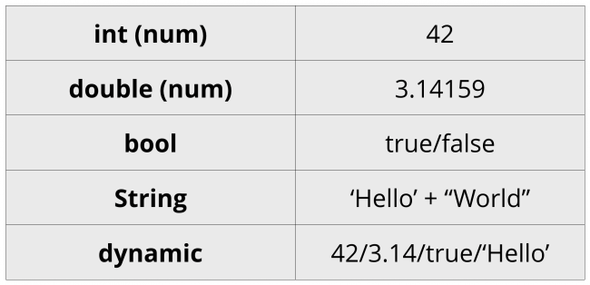
Basic Dart Types
int: Integers
double: Floating-point numbers
bool: Booleans
String: Sequences of characters

Slide 7
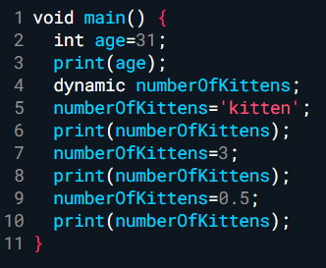
The Dynamic Keyword
If you use the dynamic keyword instead of var.

Slide 8
Operators
Dart has all the usual operators you’re familiar with from other languages like C, Java etc…
arithmetic
equality
increment and decrement
comparison
logical

Slide 9
Strings
var firstName = 'Albert';
String lastName = "Einstein";
Strings are expressed in Dart using text surrounded by either
single or double quotes.
you can embed the value of an expression inside a string by using the dollar sign symbol:
void main() {
for (int i = 0; i < 5; i++) {
print('hello ${i + 1}');
}
}

Slide 10
Immutability
Dart uses the keywords const and final for values that don’t change.
Use const for values that are known at compile-time.
Use final for values that don’t have to be known at compile-time but cannot be reassigned after being initialized.
final String moon = 'Europa';
print('$planet has a moon, $moon');
// Jupiter has a moon, Europa

Slide 11
Nullability
In the past, if you didn’t initialize a variable, Dart gave it the value null, which means nothing was stored in the variable.
Additionally, Dart guarantees that a non-nullable type will never contain a null value. This is known as sound null safety.
String? middleName;
print(middleName); // null

Slide 12
Null-Aware Operators
Dart has some null-aware operators you can use when you’re working with null values.
The double-question-mark operator, ??, is like the Elvis operator in Kotlin: It returns the left-hand operand if the object isn’t null. Otherwise, it returns the right-hand value:
var name = middleName ?? ‘default';
print(name); // default
The ?. operator protects you from accessing properties of null objects. It returns null if the object itself is null. Otherwise, it returns the value of the property on the right-hand side:
print(middleName?.length); //null
Notes:
void main() {
String? n;
Print(n.length); //Error: Property 'length' cannot be accessed on 'String?' because it is potentially null. print(n.length);
var name = n ?? "default";
print(name);
}

Slide 13
Control Flow
Control flow lets you dictate when to execute, skip over or repeat certain lines of code.
Conditionals
While Loops
Continue and Break
For Loops

Slide 14
Using For Loops
for loop
for… in loop
for each loop

Slide 15
for loop
For loop in Dart is similar to that in Java and also the flow of execution is the same as that in Java. Syntax:
for(initialization; condition; test expression){
// Body of the loop
}
Notes:
void main()
{
for (int i = 0; i < 5; i++) {
print(‘hi’);
}
}

Slide 16
for…in loop
For…in loop in Dart takes an expression or object as an iterator. It is similar to that in Java and its flow of execution is also the same as that in Java.
Syntax:
for (var in expression) {
// Body of loop
}
Notes:
var abc = [ 1, 2, 3, 4, 5 ];
for (int i in abc) {
print(i);
}

Slide 17
for each … loop
The for-each loop iterates over all elements in some container/collectible and passes the elements to some specific function.
Syntax:
collection.foreach(void f(value)); // f can be any function to execute the task
Notes:
var abc = [1,2,3,4,5];
abc.forEach((var num)=> print(num));

Slide 18
Collections
Collections are useful for grouping related data.
Dart has different types of collections, we will cover the two most common ones:
List and Map.
Others are Set, Queue, SplayTreeMap
List: an ordered collection of objects with a length (also called an array)
Set: an unordered collection of unique objects
Map: an unordered collection of key-value pairs
Queue: an ordered collection that can add/remove objects on both ends
SplayTreeMap: an ordered collection of key-value pairs based on a self-balancing binary tree.
NOTE: Each of these collection types implements Iterable, which provides common behavior like running a function on each object in the collection, getting the first object, determining the length of the collection, and more.
Notes:
void main() { Iterable<int> var1 = [1,2,3,4]; Iterable<String> var2 = ['a','b','c','d']; }
void main() { Iterable<int> var1 = [1,2,3,4]; Iterable<String> var2 = ['a','b','c','d']; print(var1.elementAt(1));
The difference with List and Iterable is that that element in the list can be accessed with their index value using [] operator while in Iterable value can’t be accessed using [] operator.
void main() { Iterable<int> var1 = [1,2,3,4]; Iterable<String> var2 = ['a','b','c','d']; print(var1[1]); }
Correct program:
void main() { Iterable<int> var1 = [1,2,3,4]; Iterable<String> var2 = ['a','b','c','d']; print(var1.elementAt(1)); }
Using for loop to print element of iterable:
void main() { Iterable<int> var1 = [1, 2, 3, 4]; for (var element in var1) { print(element); } }
Performing few operations:
void main() { Iterable<int> var1 = [1, 2, 3, 4]; print(var1.first); print(var1.last); print(var1.length); print(var1.contains(1)); print(var1.skip(1)); print(var1.single); }
Last line in above statement: prints “Throw this error if it has more than one element or empty Uncaught Error: Bad state: Too many elements .”

Slide 19
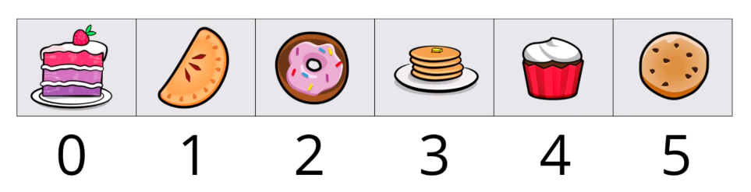
LIST
Lists in Dart are similar to arrays in other languages.
Its used for order list of values.
Starts with ‘0’ in the index.
List desserts = ['cookies', 'cupcakes', 'donuts', 'pie'];
Add and remove elements with add and remove methods respectively:
desserts.add('cake');
print(desserts);
desserts.remove('donuts');
print(desserts);
// [cookies, cupcakes, pie, cake]
Notes:
There are two types of List:
Fixed-Length List
Growable List
Fixed-Length List is a list that can’t be changed once initialized whereas the Growable list is dynamic in nature.
Fixed-length List
Creating a Fixed-length List
void main() { List<String> list = List(5); }
Here the list is empty, so let's assign the value for each index:
void main() { List<String> list = List(5); list[0] = 'a'; list[1] = 'b'; list[2] = 'c'; list[3] = 'd'; list[4] = 'e'; }
Printing the values:
print(list[1]);
Growable List
Growable List example:
void main() { List<String> list = List(); }Inserting elements in List:
void main() { List<String> list = List(); list.add('a'); list.add('b'); list.add('c'); }
Updating element:
void main() { List<String> list = List(); list.add('a'); list.add('b'); list.add('c'); list[1]= 'm'; }

Slide 20
Set
A set is an unordered collection of values.
We can’t get the values by their index values as they are unordered.
Values in set are unique ie they cant be repeated.
Notes:
Creating a Set using a constructor:
Set<int> set = Set();
Creating a Set using List
void main() { List<int> list = [1, 2, 3, 4]; Set<int> set = Set.from(list); }
Inserting elements in Set:
void main() { List<int> list = [1, 2, 3, 4]; Set<int> set = Set.from(list); set.add(5); set.add(6); }

Slide 21
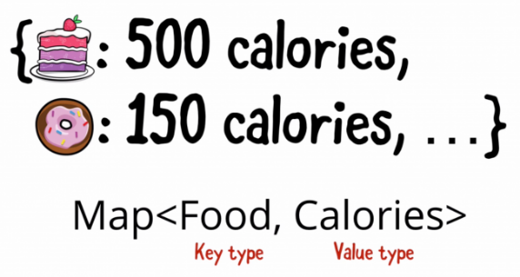
Maps
When you want a list of paired values, Map is a good choice.
Elements of a map are called key-value pairs, where the key is on the left of a colon and the value is on the right.
Size of map is not fixed.
Map is also called dictionary or hash.
Map<String, int> map = Map();
Map<String, int> calories = {
'cake': 500,
'donuts': 150,
'cookies': 100,
};
Notes:
void main() { Map<String, int> map = Map(); map['number'] = 1; print(map); }
Printing all keys and values of the map:
void main() { Map<String, int> map = Map(); map['number1'] = 1; map['number2'] = 2; map['number3'] = 3; for (String keys in map.keys) { print(keys); } for (int values in map.values) { print(values); } }
Printing Key-Value pair:
map.forEach((key, value) { print("$key:$value"); });

Slide 22
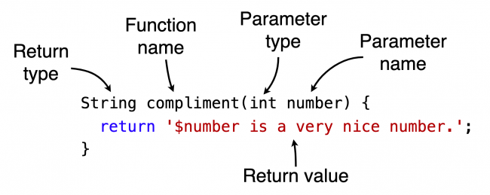
Functions
Function is a block of code that should be organized, perform a single task, and should be related to the class.
Functions should also be reusable.
A function consists of the following elements:
Return type
Function name
Parameter list in parentheses
Function body enclosed in brackets
Notes:
Syntax : return_type func_name (parameter_list)
{
//Statement(s)
return value;
}
int getNum(){
return 9;
}
Calling the function:
print(getNum());

Slide 23
Optional Parameters
If a parameter to a function is optional, you can surround it with square brackets and make the type nullable:
String fullName(String first, String last, [String? title]) {
if (title == null) {
return '$first $last';
} else {
return '$title $first $last';
}
}
print(fullName('Joe', 'Howard')); // Joe Howard
print(fullName('Albert', 'Einstein', 'Professor'));// Professor Albert Einstein

Slide 24
Named Parameters and Default Values
bool withinTolerance({required int value, int min = 0, int max = 10}) {
return min <= value && value <= max;
}
print(withinTolerance(min: 1, max: 5, value: 11)); // false
print(withinTolerance(value: 5)); // true

Slide 25
Intro to Flutter
Flutter is a cross-platform framework.
Flutter apps use the Dart programming language.
Flutter doesn’t need to use a JavaScript bridge, which improves app startup times and overall performance.
Flutter framework is built around the idea of widgets.
Notes:
You can also transcompile Dart into JavaScript code. https://dart.dev/tools/dart2js
Dart achieves this by using Ahead-Of-Time (AOT) compilation.
Dart can also use Just-In-Time (JIT) compilation. JIT compilation with Flutter improves the development workflow by allowing a hot reload capability to refresh the UI during development without the need for an entirely new build.

Slide 26
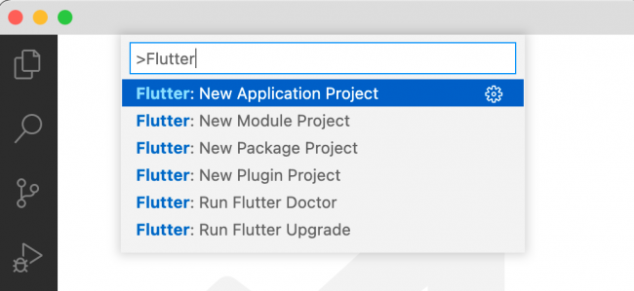
Creating new project
Notes:
lib folder that contains main.dart and will have code that applies to both platforms.

Slide 27
Running flutter App
https://docs.flutter.dev/get-started/install/windows#set-up-your-android-device

Slide 28
Hot reload vs. hot restart
Hot reload works by injecting updated source code files into the running Dart VM (Virtual Machine). This includes not only adding new classes, but also adding methods and fields to existing classes, and changing existing functions. A few types of code changes cannot be hot reloaded though:
Global variable initializers
Static field initializers
The main() method of the app
For these changes, fully restart your application without having to end your debugging session. To perform a hot restart, run the Flutter: Hot Restart command from the Command Palette, or press Ctrl+Shift+F5(Cmd+Shift+F5 on macOS).

